Slide 1
Wifi Embedded Webcam
Kishan Jaishwal (20)
Prajwol Lamichhane (26)
Anukul Parajuli (34)
Abhay Raut (43)
Subarna Subedi (55)
Notes:
<number>

Slide 2
What / Why “WiFi Embedded Webcam”?
What : A WIFI embedded webcam is a camera that sends live pictures or videos to a computer through a network.
Why: Due to increase in security issues and to demonstrate how small ideas can really make changes

Slide 3
Objectives
To know how an internet based webcam system is developed that allows people to view activities around their offices and homes on their WIFI connected laptop or mobile devices
To learn how the security around house and offices are increased through the continuous
live stream of the real time video sent from the webcam via the internet
To learn more about how embedded systems work and how they are used in real life situations
To develop ideas for its further enhancement which could be implemented in other sectors

Slide 4
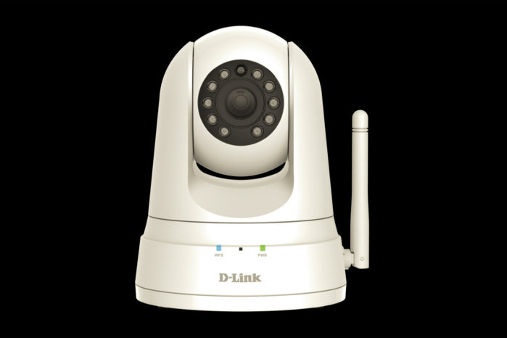
Related Works
A. D-Link Camera
1. Infrared (Night vision)
2. Motion Detection
3. Low resolution (640*480)
4. 150-300 Mbps
5. Smart Alerts

Slide 5
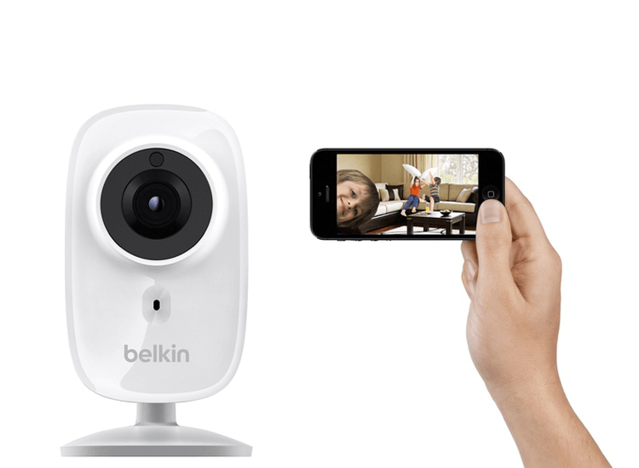
Related Works
B. Belkin NetCam HD
1. 900 Mbps
2. Glass Lens
3. Cloud Facilities
4. Easy Setup
5. Night Vision(IR)
6. Wide-Angle
7. Motion Sensor

Slide 6
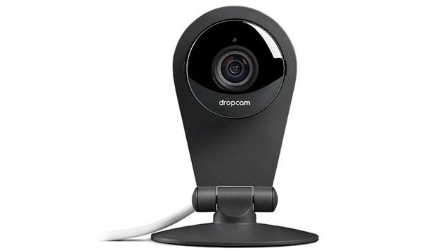
Related Work
C. DropCam
1. Can integrate with Alexa
2. 60 - second setup
3. 5 GHZ
4. Wide Angle View(130 degree)
5. Night Vision and Zoom mode

Slide 7
Take Away
Easy to use
Free
Arduino Based
Secure
Realtime
Multifunctional

Slide 8
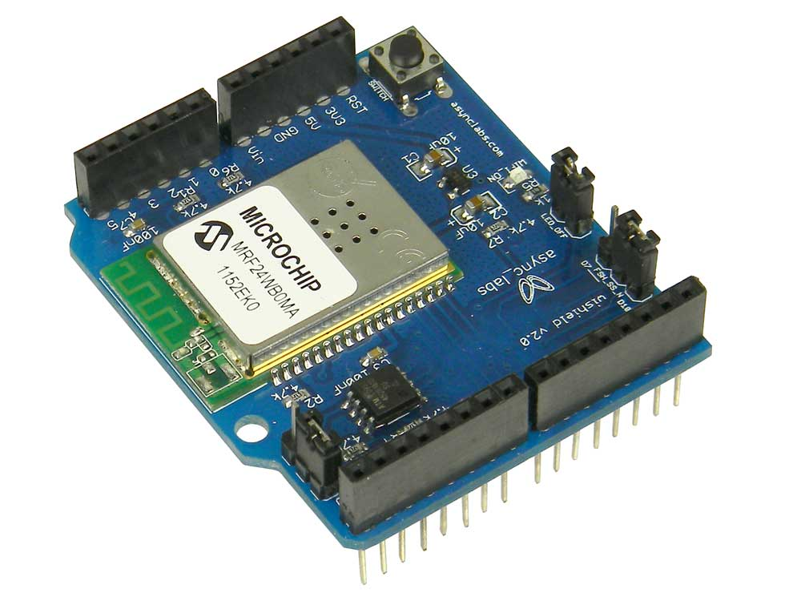
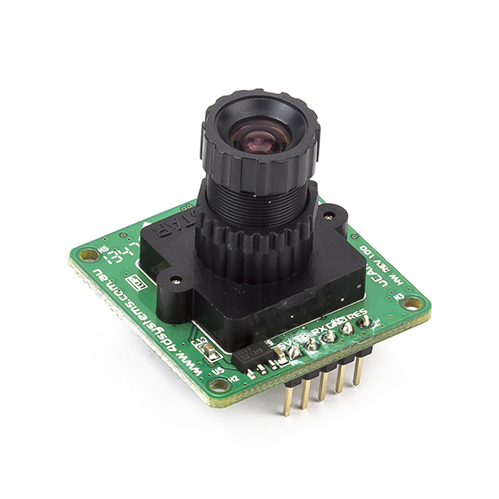
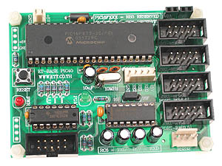
Hardware Used
MRF24WBOMA Wi-Fi module
A Camera module
PIC Controller

Slide 9
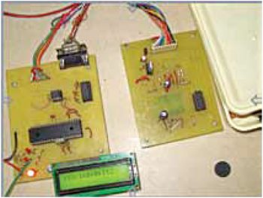
Hardware Used
Fig: WIFI Embedded Webcam

Slide 10
Limitations
Motion detection failure due to low frame rate
Frame rate and quality depends on internet speed
Time delay in actual image and resulting image may cause significant failure in security

Slide 11
Future Enhancement
Easier for user to set-up (automatic)
Increased resolution of camera
High audio quality
Sharper motion detection algorithm
Additional mode of communication except internet

Slide 12
Conclusion
Although the necessity for inventing webcam were realized due to raise in theft and robbery in the recent times but it further had many more applications. Personal Relationships, having a webcam helps you keep in touch with your loved ones whiles seeing their faces and expressions. Education and Training, webcam has made distance learning more easier and accessible. Webcam are very versatile i.e. they can be used in different fields for specific purposes.

Slide 13
Thank You

